Slide 1
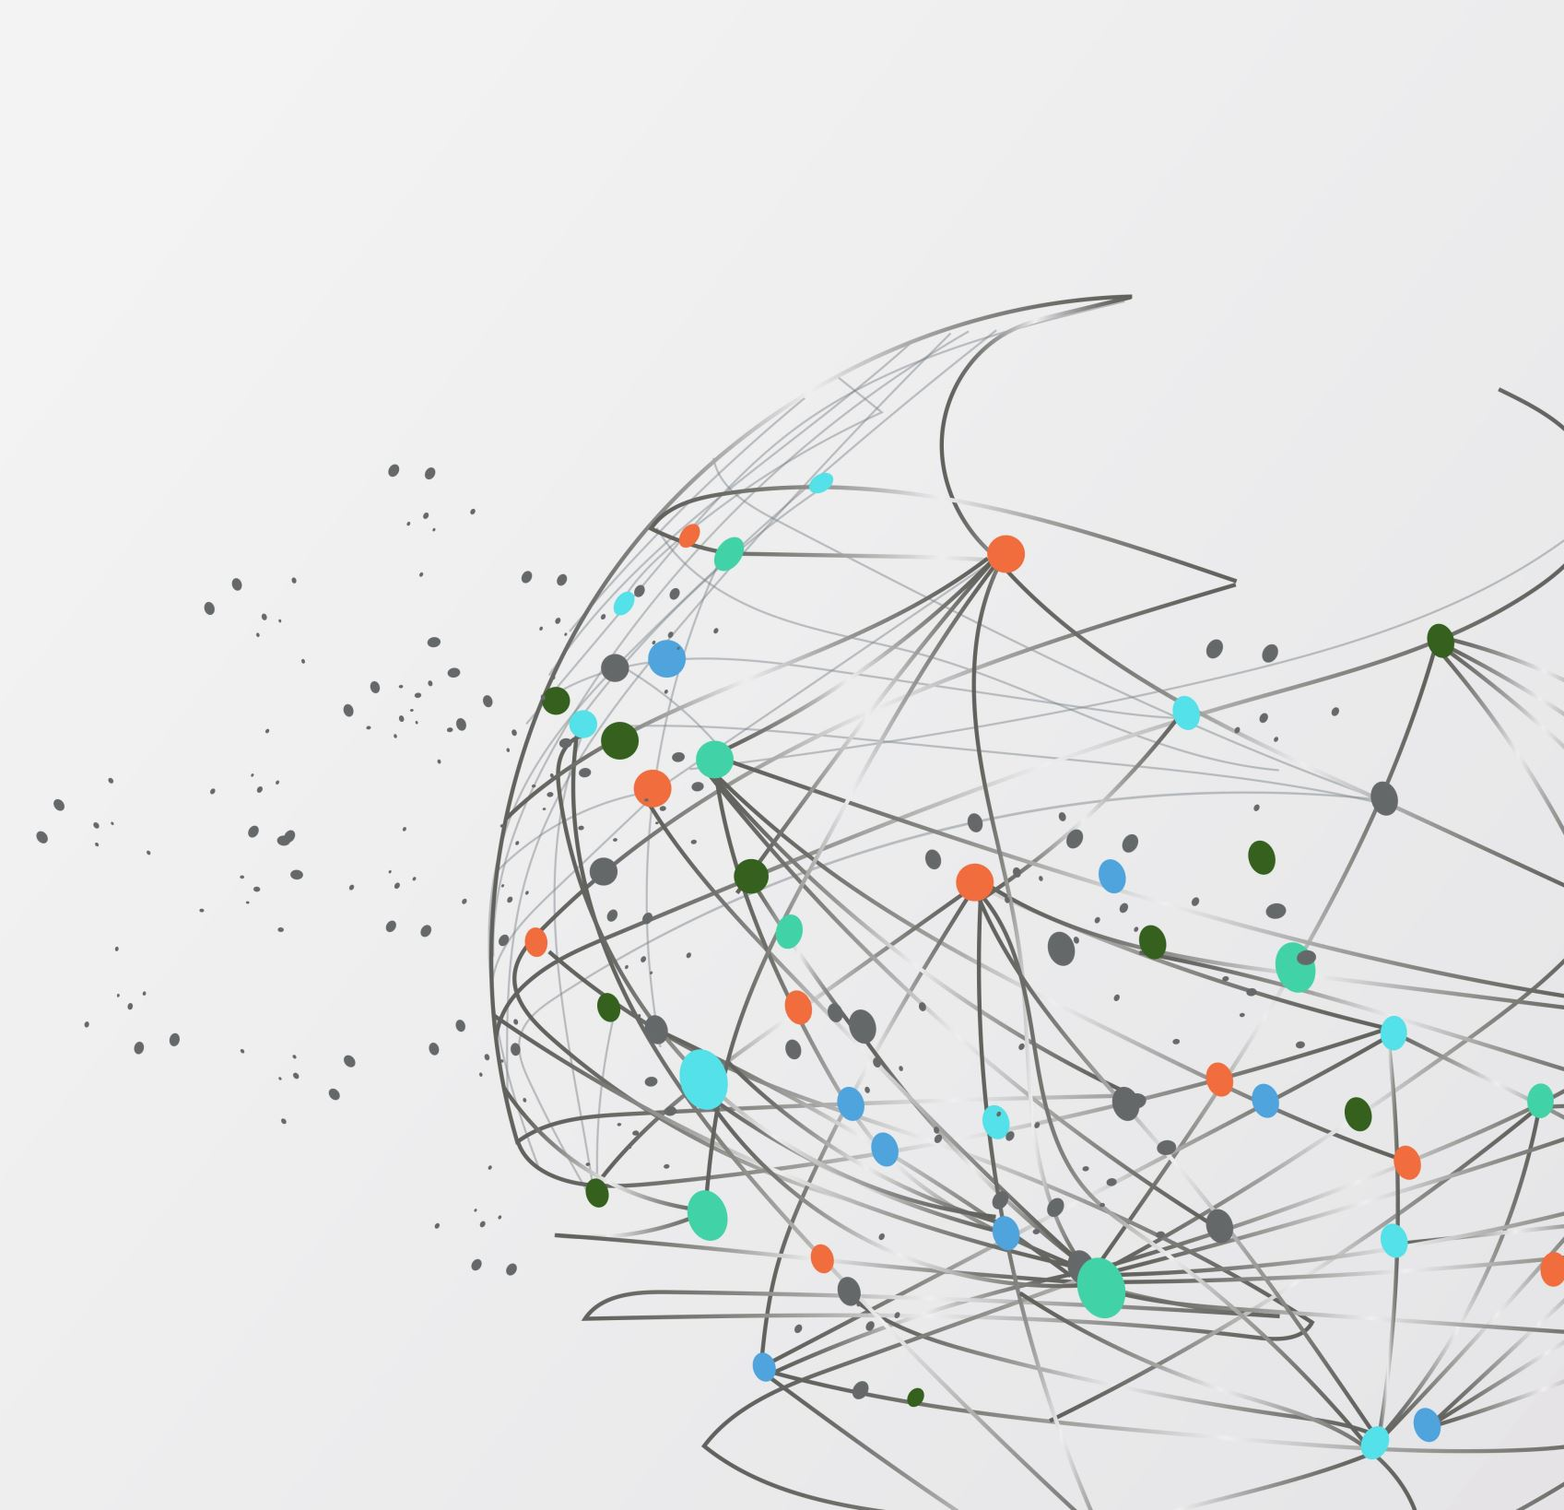
CS250 SDLC
Scrum
Presented By:
Jerimey Burnside
04/16/2023

Slide 2
Scrum-agile team
A Scrum-agile team is a cross-functional group of individuals who work together to deliver high-quality products or services. The team consists of several roles, including the Product Owner, Scrum Master, and Development Team. Each role has specific responsibilities that contribute to the success of the project.
Scrum-agile team include:
The Product Owner
The Scrum Master
The Development Team
The Tester(s)

Slide 3

The Product Owner
The Product Owner is responsible for defining and prioritizing the product backlog, which is a list of all the features and requirements needed for the product. The Product Owner works closely with stakeholders to understand their needs and ensure that the product meets their expectations. They also communicate with the Development Team to ensure that everyone understands the requirements and priorities.

Slide 4
The Scrum Master
The Scrum Master is responsible for ensuring that the Scrum framework is followed correctly. They facilitate meetings such as Sprint Planning, Daily Stand-up, Sprint Review, and Sprint Retrospective. The Scrum Master also removes any impediments that may hinder progress and ensures that the team is working efficiently.

Slide 5
The Development Team
is responsible for delivering a potentially shippable product increment at the end of each sprint. The team consists of individuals with different skills and expertise who work together to complete tasks from the product backlog. They are self-organizing and cross-functional, meaning that they collaborate to complete tasks regardless of their specialization.

Slide 6
The Tester(s)
Testers are an integral part of the development team and collaborate closely with developers, product owners, and other stakeholders. They participate in all Scrum ceremonies such as sprint planning, daily stand-ups, sprint reviews, and retrospectives. Testers provide feedback to the team on the quality of the product and identify potential risks associated with new features.

Slide 7
The key facets of the Scrum-Agile approach
Iterative and incremental delivery: Scrum-Agile projects are divided into short iterations, usually 2-4 weeks long, called sprints. At the end of each sprint, a potentially shippable product increment is delivered. This allows stakeholders to provide feedback early and often which enables the team to adjust course as needed.
Self-organizing teams: Scrum-Agile teams are cross-functional and self-organizing, meaning they have the autonomy to decide how to best accomplish their work. The team is responsible for planning and executing the work, and for continuously improving their processes.
Product backlog: The product backlog is a prioritized list of features or requirements that the team will work on during the project. The backlog is owned by the product owner, who is responsible for ensuring that it reflects stakeholder needs and priorities.
Daily stand-up meetings: Daily stand-up meetings, or scrums, are short meetings where team members share updates on their progress and discuss any obstacles they are facing. This helps to keep everyone aligned and focused on the goal.
Sprint review and retrospective: At the end of each sprint, the team holds a sprint review meeting to demonstrate the work they have completed and receive feedback from stakeholders. They also hold a sprint retrospective meeting to reflect on what went well, what could be improved, and make adjustments for the next sprint.
Visual management: Scrum-Agile teams often use visual management tools such as Kanban boards or burndown charts to track progress and make work visible.
Overall, the Scrum-Agile approach is designed to promote collaboration, transparency, and continuous improvement. By breaking work into small, manageable chunks and focusing on delivering value early and often, teams can adapt to changing requirements and deliver high-quality products that meet stakeholder needs.

Slide 8
Consider when to choose a waterfall approach or an agile approach.
Agile approach
The agile approach is an iterative and incremental methodology that emphasizes flexibility and adaptability.
Waterfall approach
The waterfall approach is a traditional project management methodology that follows a sequential process, where each phase must be completed before moving on to the next.

Slide 9
Consider when to choose a waterfall approach or an agile approach.
One of the main factors to consider when choosing between these two approaches is the nature of the project itself. Waterfall is best suited for projects with well-defined requirements and a clear understanding of the end goal. If the project has a fixed budget, timeline, and scope, then the waterfall approach may be more appropriate. On the other hand, if the project is complex and requires frequent changes or additions to requirements, then an agile approach may be more effective.

Slide 10
Consider when to choose a waterfall approach or an agile approach.
Another factor to consider is the level of collaboration required among team members. Waterfall projects typically involve a hierarchical structure with clearly defined roles and responsibilities. In contrast, agile projects require more collaboration and communication among team members, as well as with stakeholders. If the project requires frequent feedback and input from stakeholders, then an agile approach may be more suitable.

Slide 11
Consider when to choose a waterfall approach or an agile approach.
Finally, it's important to consider the level of risk involved in the project. Waterfall projects are generally less risky because they follow a predictable path with clearly defined milestones. However, if there is a high level of uncertainty or risk involved in the project, then an agile approach may be better suited because it allows for more flexibility and adaptation.

Slide 12
Consider when to choose a waterfall approach or an agile approach.
In conclusion, when choosing between a waterfall approach or an agile approach, it's important to consider the nature of the project, level of collaboration required among team members, and level of risk involved.

Slide 13
References:
What is Agile Software Development? (2023) Agile Alliance |. Retrieved April 13, 2023, from http://www.agilealliance.org/agile101/
The scrum guide. Scrum.org. (n.d.). Retrieved April 13, 2023, from http://www.scrum.org/resources/scrum-guide
Wallace, P. M. (2013). Information systems in organizations: People, Technology, and Processes. Pearson.
Agile Manifesto. “Manifesto for Agile Software Development.” Agilemanifesto.org, 2001, agilemanifesto.org/. Accessed 15 Apr. 2023.

